Slide 1

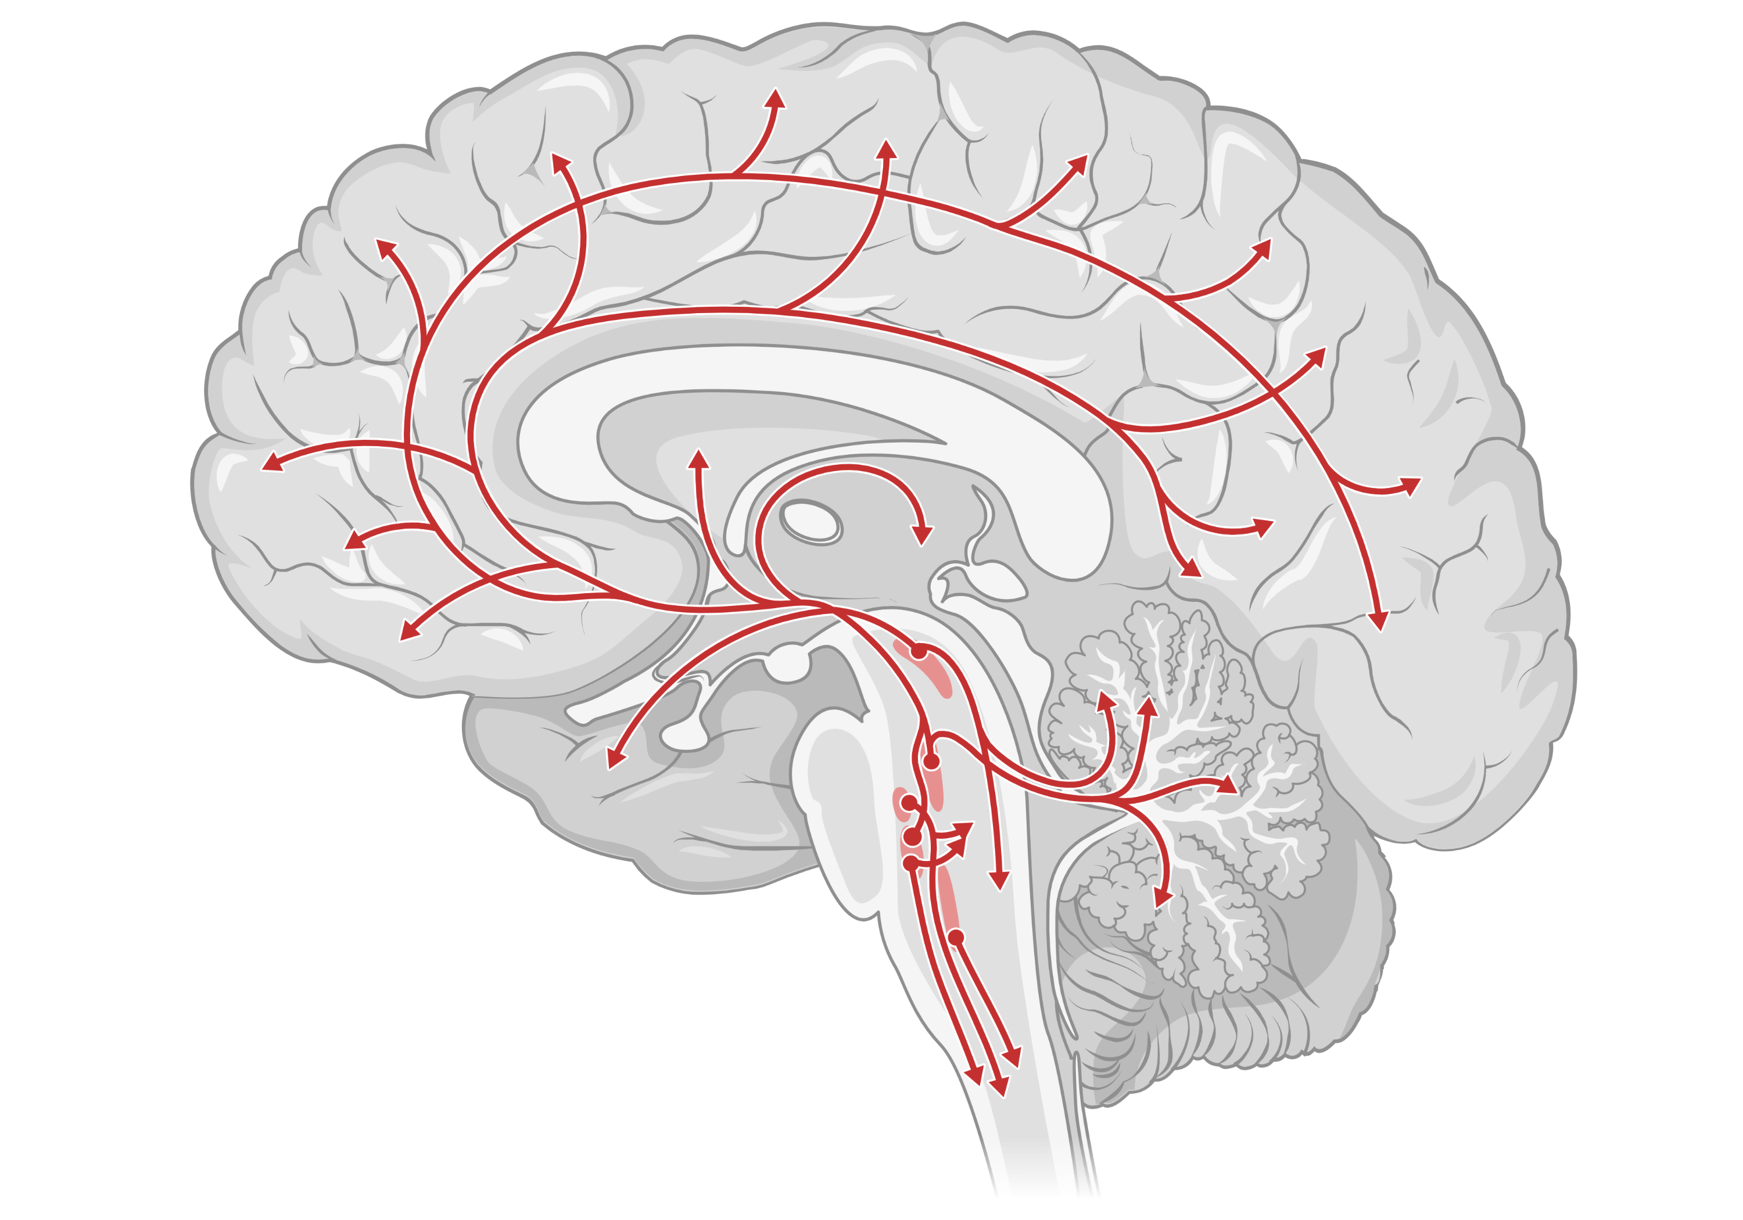
Screening & Diagnosis
Management of Unipolar Major Depression and Generalized Anxiety Disorder
Primary Care Essentials
Differential
Treatment
Medications
Cases
Graphic created with BioRender.com

Slide 2
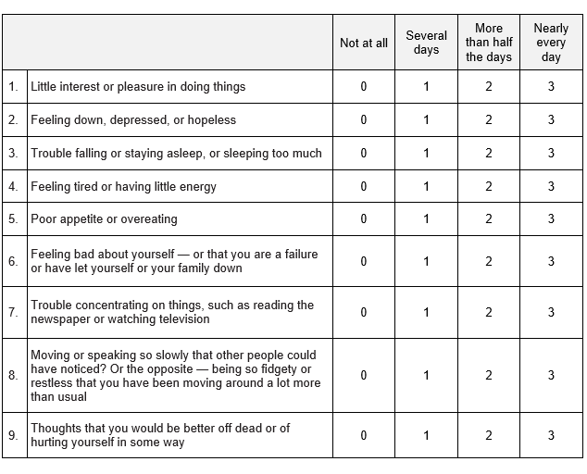
Screening & Diagnosis
Why Screen?
Screening doubles detection of depression.
Treatment of depression -> Improves quality of life, reduces mortality, and reduces economic burden
Why screen?
Differential
Screening and Diagnosis Tools
Diagnosis: Must cause impairment of social, occupational, or other important areas of functioning. Score defines severity.
Treatment
In the past two weeks have you felt:
PHQ-9
Unipolar Major Depressive Disorder
Unipolar Major Depressive Disorder
Medications
Cases
Low risk screen?
Low risk screen
Generalized Anxiety Disorder

Slide 3
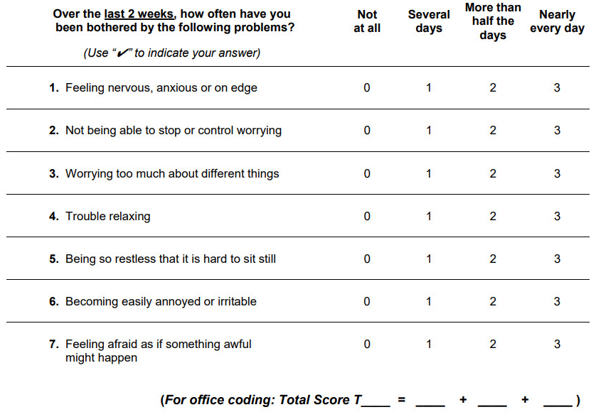
Screening & Diagnosis
Why?
Screening doubles detection of depression.
Treatment of depression -> Improves quality of life, reduces mortality, and reduces economic burden
Why screen?
Differential
Screening and Diagnosis Tools
GAD-7
Diagnosis: 6+ months of excessive and difficult to control anxiety with 3+ symptoms
Treatment
Unipolar Major Depressive Disorder
Medications
Cases
Generalized Anxiety Disorder
Low risk screen?
Low risk screen?
Describe the process of screening and diagnosing in your clinic?

Slide 4





Screening & Diagnosis
Labs to consider?
Differential
Treatment
CBC
BMP
HCG
TSH
Medications
Cases
Unipolar Major Depressive Disorder
Generalized Anxiety Disorder
Unipolar Major Depressive Disorder
Adjustment Disorder with Depressed Mood
ADHD
*Bipolar disorder
Borderline Personality disorder
Complicated Grief
Delirium
Hypothyroidism
Schizophrenia and Schizoaffective Disorder
Substance Use Disorders
Clues that raise suspicion of Bipolar Disease?
Age < 25
Family History of Bipolar Disorder
Multiple (at least 3-5) recurrences of Major Depression
What screening questions would you ask?

Slide 5
Screening & Diagnosis
Labs to consider?
Differential
Treatment
CBC
BMP
HCG
TSH
Medications
Cases
Unipolar Major Depressive Disorder
Generalized Anxiety Disorder
Panic Disorder
Adjustment Disorder
Obsessive-Compulsive Disorder
Separation Anxiety Disorder
Post-Traumatic Stress Disorder

Slide 6
Goals of Depression Treatment
Screening & Diagnosis
Goals of Depression Treatment
Patient focused: What are the patient’s goals for therapy?
Remission = Absence of sad mood and reduced interest x 3 weeks
Differential
Start Treatment
(Medication and/or Psychotherapy)
Equivalent response rates
Treatment
Medications
@ 1-2 weeks to confirm NO:
First follow-up?
Worsening suicidality or mania
Intolerable side-effects
Cases
Second follow-up?
@ 2-4 weeks to evaluate:
Response to therapy
Improvement in initial side effects
No response, intolerable side effects?
Partial but incomplete response?
Complete response, tolerating well?
Choose another agent
Increase Dose
Re-evaluate in 2 weeks
Maintain Dose
Consider discontinuation in 3-9 months

Slide 7
Screening & Diagnosis
SSRI
SNRI
Atypicals
TCA
Differential
“Activating”?
Fluoxetine (Prozac)
Sertraline (Zoloft)
Citalopram (Celexa)
Escitalopram (Lexapro)
Paroxetine (Paxil)
Duloxetine
Venlafaxine
Bupropion
Mirtazapine
Amitriptyline
Nortriptyline
“Activating”?
Treatment
“Sedating”?
“Sedating”?
Medications
Short ½-life?
Cases
Side Effects?
Case-dependent Selection?

Slide 8
Screening & Diagnosis
SSRI
SNRI
Atypicals
TCA
Longest ½-life
Differential
“Activating”?
Fluoxetine (Prozac)
Sertraline (Zoloft)
Citalopram (Celexa)
Escitalopram (Lexapro)
Paroxetine (Paxil)
Duloxetine
Venlafaxine
Bupropion
Mirtazapine
Amitriptyline
Nortriptyline
Treatment
“Sedating”?
Medications
Short ½-life?
More withdrawal side effects. Needs a taper.
Cases
Side Effects?
Case-dependent Selection?

Slide 9





Screening & Diagnosis
SSRI
SNRI
Atypicals
TCA
Differential
“Activating”?
Fluoxetine (Prozac)
Sertraline (Zoloft)
Citalopram (Celexa)
Escitalopram (Lexapro)
Paroxetine (Paxil)
Duloxetine
Venlafaxine
Bupropion
Mirtazapine
Amitriptyline
Nortriptyline
Treatment
“Sedating”?
Medications
Short ½-life?
Cases
Side Effects?
Sexual
Dysfunction
Insomnia
& Agitation
QTc
Prolongation
GI Toxicity
(transient)
Drowsiness
Weight Gain
Case-dependent Selection?

Slide 10
Screening & Diagnosis
SSRI
SNRI
Atypicals
TCA
Differential
“Activating”?
Fluoxetine (Prozac)
Sertraline (Zoloft)
Citalopram (Celexa)
Escitalopram (Lexapro)
Paroxetine (Paxil)
Duloxetine
Venlafaxine
Bupropion
Mirtazapine
Amitriptyline
Nortriptyline
Treatment
“Sedating”?
Medications
Short ½-life?
Cases
Side Effects?
Sexual
Dysfunction
Insomnia
& Agitation
QTc
Prolongation
GI Toxicity
(transient)
Drowsiness
Weight Gain
Case-dependent Selection?

Slide 11
Screening & Diagnosis
SSRI
SNRI
Atypicals
TCA
Differential
“Activating”?
Fluoxetine (Prozac)
Sertraline (Zoloft)
Citalopram (Celexa)
Escitalopram (Lexapro)
Paroxetine (Paxil)
Duloxetine
Venlafaxine
Bupropion
Mirtazapine
Amitriptyline
Nortriptyline
Treatment
“Sedating”?
Medications
Short ½-life?
Cases
Side Effects?
Sexual
Dysfunction
Insomnia
& Agitation
QTc
Prolongation
GI Toxicity
(transient)
Drowsiness
Weight Gain
Case-dependent Selection?

Slide 12
Screening & Diagnosis
SSRI
SNRI
Atypicals
TCA
Differential
“Activating”?
Fluoxetine (Prozac)
Sertraline (Zoloft)
Citalopram (Celexa)
Escitalopram (Lexapro)
Paroxetine (Paxil)
Duloxetine
Venlafaxine
Bupropion
Mirtazapine
Amitriptyline
Nortriptyline
Treatment
“Sedating”?
Medications
Short ½-life?
Cases
Side Effects?
Sexual
Dysfunction
Insomnia
& Agitation
QTc
Prolongation
GI Toxicity
(transient)
Drowsiness
Weight Gain
Case-dependent Selection?

Slide 13
Screening & Diagnosis
SSRI
SNRI
Atypicals
TCA
Differential
“Activating”?
Fluoxetine (Prozac)
Sertraline (Zoloft)
Citalopram (Celexa)
Escitalopram (Lexapro)
Paroxetine (Paxil)
Duloxetine
Venlafaxine
Bupropion
Mirtazapine
Amitriptyline
Nortriptyline
Treatment
“Sedating”?
Medications
Short ½-life?
Cases
Side Effects?
Sexual
Dysfunction
Insomnia
& Agitation
QTc
Prolongation
GI Toxicity
(transient)
Drowsiness
Weight Gain
Case-dependent Selection?

Slide 14
Screening & Diagnosis
SSRI
SNRI
Atypicals
TCA
Differential
“Activating”?
Fluoxetine (Prozac)
Sertraline (Zoloft)
Citalopram (Celexa)
Escitalopram (Lexapro)
Paroxetine (Paxil)
Duloxetine
Venlafaxine
Bupropion
Mirtazapine
Amitriptyline
Nortriptyline
Treatment
“Sedating”?
Medications
Short ½-life?
Cases
Side Effects?
Sexual
Dysfunction
Insomnia
& Agitation
QTc
Prolongation
GI Toxicity
(transient)
Drowsiness
Weight Gain
Case-dependent Selection?

Slide 15

Screening & Diagnosis
SSRI
SNRI
Atypicals
TCA
Differential
1
“Activating”?
Fluoxetine (Prozac)
Sertraline (Zoloft)
Citalopram (Celexa)
Escitalopram (Lexapro)
Paroxetine (Paxil)
Duloxetine
Venlafaxine
Bupropion
Mirtazapine
Amitriptyline
Nortriptyline
Treatment
2
3
“Sedating”?
Medications
Short ½-life?
Cases
Transient
Side Effects?
Sexual
Dysfunction
Insomnia
& Agitation
QTc
Prolongation
GI Toxicity
Drowsiness
Weight Gain
1
2
3
Case-dependent Selection?
Young, sleepy, smoker, concerned about weight and sexual dysfunction.
Young, anxious, no weight or sexual dysfunction concerns.
Old, insomnia, decreased appetite

Slide 16

Case 1
Case 2
Case 3
25-year-old man presents to establish care with his primary care doctor. He reports no past medical history and otherwise feels well. He moved from Chicago 2 months ago and has noticed increasing feelings of loneliness and sadness over the past several weeks. He also reports increasing stress with his new job
79-year-old woman presents to her geriatrician for evaluation of fatigue and poor concentration. She has a PMH of HTN, RA, and CAD. Her symptoms started approximately 6 months ago after a MI. Her follow up with her cardiologist has been normal. She denies chest pain, dizziness, lightheadedness.
28-year-old woman presents with general arthralgias and low back pain that started several years ago. She feels “restless” and “on edge”, which has been going on since she was in her late teens. She states she has had intermittent depression but has never sought treatment as these episodes resolved on their own. She drinks 2 glasses of wine each night to help with sleep.
VS: Ht 5’3”, Wt 125 lbs, HR 72, BP 120/80, RR 16, SpO2 95%
PE: Unremarkable MSK exam
VS: Ht 5’10”, Wt 130lbs (previously 146), HR 82, BP 138/80, RR 16, SpO2 95%
Exam: Unremarkable cardiac, neuro and pulmonary exams.
Meds: Carvedilol, Losartan, MTX, ASA, Atorvastatin
Which screening test is most appropriate?
PHQ-9 (seen here), also consider GAD-7
What screening labs and questionnaires would be appropriate?
Which screening test is most appropriate?
After further questioning, patient meets criteria for Moderate Depression, what is the next step?
GAD-7, AUDIT/CAGE, PHQ-9
EKG, CBC, BMP, TSH. PHQ-9 or GDS-5, MOCA
You diagnose her with Unipolar Depression, and Generalized Anxiety Disorder. What do you offer for treatment?
Suicide Risk Assessment
Her labs, ECG, and MOCA are unremarkable and her GDS-5 is positive. What treatment regimen would you recommend?
Physical Therapy, CBT, Duloxetine
Patient denies active suicidal ideation and has no prior history of suicide attempts. What medication would you recommend?
On 8 week follow up, she is on a max dose of duloxetine and her GAD7 has improved but is still showing moderate anxiety. Next step?
Citalopram or Mirtazapine, CBT
SSRI or SNRI, consider avoiding Paroxetine
Patient starts Citalopram (10mg) and returns in 2 weeks. She reports mild diarrhea that has since improved. Her GDS-5 is unchanged. Next step?
Switch to different SRI, or add Pregabalin/Buspirone
When should this patient return for follow up?
She switches to sertraline and on follow-up 2 weeks later, reports feeling “better than ever”. Her energy is at an “all time high” and her pain is “entirely gone”
1-2 weeks for side effect evaluation and dosage increase
Increase Citalopram to 20mg
Reassess Diagnosis

Slide 17
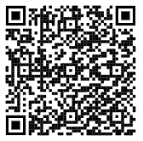
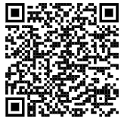
Assessing Suicide Risk
Critical step at each visit while treating patients for depression and anxiety. Use Clear language. Final question in PHQ-9.
Describe the next steps in managing a patient with active suicidal ideation in your clinic.
Where is your safety plan handouts?
What mental health resources are immediately available?
Next steps
National Institute of Mental Health
Columbia Suicide Severity Rating Scale
Additional Assessment Tools
Short (5 questions)
Needs further questioning about safety if positive
Very long and detailed.
BACK

Slide 18
Interpretation:
Remember, PHQ-9 is a screening test and does not diagnose. But CAN measure severity and trend response to therapy.
PHQ score ≥ 10: Likely Major Depression
5-9: Mild Depression
10-14: Moderate
15-19: Moderately Severe
≥ 20: Severe
Total Score: 10
BACK

Slide 19
2022–2025 Update — Screening & Newer Agents
USPSTF 2023 (final): screen ALL adults for DEPRESSION (Grade B) and adults <65 for ANXIETY disorders (Grade B); both include pregnant/postpartum. Insufficient evidence to screen for anxiety at ≥65 (I). No routine suicide-risk screening in asymptomatic adults (I).
Antidepressant discontinuation: ANTLER trial (Lewis, NEJM 2021) — stopping after long-term use → ~56% relapse vs ~39% maintained. Taper slowly; withdrawal can be prolonged.
Newer oral agents (context, not first-line for routine GAD/MDD):
• Dextromethorphan–bupropion (Auvelity) — FDA Aug 2022; first rapid-acting oral NMDA-antagonist for MDD (separation from placebo by week 1).
• Zuranolone (Zurzuvae) — FDA Aug 2023; first ORAL agent for POSTPARTUM depression (14-day course); not approved for general MDD.
• Esketamine (Spravato) intranasal — treatment-resistant MDD; expanded to monotherapy 2025.
Standing teaching (PHQ-9/GAD-7, SRI first-line, close early follow-up, side-effect-guided selection) verified CURRENT — no change.

Slide 20
Take-Home Points
PHQ-9 and GAD-7 are the preferred tools to DIAGNOSE and MONITOR unipolar depression and GAD; PHQ-2/PHQ-4 are screens only — don't use them when pretest probability is high.
Short-term follow-up (within ~1–2 weeks) after starting a drug is critical — watch for emergent suicidality/mania, intolerable side effects, and non-adherence.
SRIs are first-line for both; pick the agent by comorbidity, prior response, cost, preference, and SIDE-EFFECT profile (use side effects to your advantage).
Treat the somatic symptoms too (e.g., PT, headache care) and keep re-screening for bipolar disorder and substance use.
USPSTF 2023: screen all adults for depression and adults <65 for anxiety.

Slide 21
Attribution & Optimization Notes
Adapted from TeachIM.org — “Depression and Anxiety” (Trefilek, Melton, Guinn, Fainstad; Section Ed. Brett; Univ. of Colorado). Published Dec 2021, updated Nov 2022.
Source URL: https://teachim.org/teaching_material/depression-and-anxiety/
Licensed under Creative Commons Attribution-NonCommercial 4.0 (CC BY-NC 4.0). This optimized package is likewise CC BY-NC 4.0 — attribution required, non-commercial use only.
Optimized June 2026: original interactive board preserved (all 18 slides, animations & BioRender graphics intact); no factual/typo errors found → append-only edit (this 3-slide addendum).
Currency verified vs USPSTF 2023 screening recommendations, ANTLER (NEJM 2021), and FDA approvals (Auvelity 2022, Zurzuvae/zuranolone 2023). Companion: Depression-learner-handout.docx.
Educational use only — clinician-reviewed before teaching. Suicide risk is a sensitive topic; ensure local crisis resources are available.

